Slide 1
Substance Use Disorders and Mental Health and Cognitive Challenges
Presented by:
Rick Krueger, MA, LPC, LADC
Clinical Services Manager
Vinland National Center

Slide 2
Agenda
Prevalence and physical causes of TBI and intellectual disabilities
Psychosocial, physical, and social effects of TBI and intellectual disabilities
Benefits of Complementary Care
  Illness Management and Recovery (IMR)
  Therapeutic Exercise
  Mindfulness-based Meditation
  Trauma Informed Care
  Resilience Training

Slide 3
Prevalence of Comorbidy
The CDC estimated that 5.3 million Americans live with disabilities due to brain injury and that 67% of people in rehabilitation for brain injury have a previous history of substance abuse (Thurman, 1998). 50% of these people will return to using alcohol and drugs after the injury (Corrigan, 1995).

Slide 4
Overview of Disabilities
Attention Deficit Disorders
Developmental Disability
Brain Attack
Traumatic Brain Injury
Physical Disabilities
Illness/Infection
Anoxia
Learning Disabilities
SPMI

Slide 5
Physical Causes
Developmental disability
Brain attack
Heart attack
Infection
Learning disability
Fetal alcohol
Birth related
Trauma
  Traumatic brain injury
  Physical disability

Slide 6

Psychosocial Effects/Changes
Anger / Aggression
Social inappropriateness
Difficulty managing money
Following directions
Formulation goals
Starting and completing tasks
Speaking clearly

Slide 7
Physical Effects / Changes
  Muscle movement
  Muscle coordination
  Sleep
  Hearing
  Vision
  Taste
  Smell
  Touch
  Fatigue
  Weakness
  Balance
  Speech
  Seizures
  Sexual functioning

Slide 8
Social Effects and Changes
Orientation
Concentration
Mental control
Shifting thoughts
Sequencing
Perseveration
Memory verbal and non-verbal
Reasoning verbal and non-verbal
Learning over time
Linear thought process
Mechanical manipulation
Perception
Planning
Foresight
Language

Slide 9
Consequences of Disability
Memory impairment – short and long term
Decreased self awareness/insight
Impairment in abstract thinking
Increased concrete thinking
Attention deficits/concentration
Reduced ability to process information

Slide 10
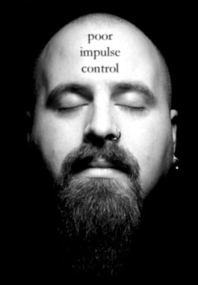
Consequences of Disability
Sensory deficits – smell, taste, touch, vision
Reduced initiation and what may appear to be motivation
Disinhibition – decrease impulse control
Altered self image

Slide 11
Treatment for People with TBI
Adapt treatment techniques for people with TBI so that:
There is an increased opportunity for success
The patient can understand what is required by the program
The patient can act appropriately and understand behavior concerns
TBI education is as important as is the drug/alcohol education for this patient.
The treatment of both recovery and cognitive needs produces the best outcomes

Slide 12
Group Approach
  Give a group orientation
  Do not overwhelm
  Rate of information is critical
    Verbal and written with repetition is useful
    Practice new skills
  Role play
  Be concise
  Encourage note taking
  Be aware of vocabulary problems, especially when using specialized or treatment language
    Always define and give examples
  Summarize statements to check patients’
  Ask clients to present their own summary statements

Slide 13
Treatment
Compensatory Strategies
  Date books and calendars to record appointments and daily schedule
  Notebook to record important information and notes from groups and counseling sessions
  Wristwatch alarms
  Post – Its
  Visual cues (pictures, maps, diagrams)
  Information, guidelines and expectations should be reviewed often and should be very specific
  Offer immediate and specific feedback about behavior
    Give concrete suggestions and examples

Slide 14
Treatment
Education about TBI and specific issues related to substance abuse
  Seizures are more likely
  Dangers of mixing alcohol and drugs
  Dangers of mixing above with prescription medications
  Increased risk of additional brain injury
    Chance of a second head injury is 3 times greater (Ohio Valley Center for Head Injury Prevention)
  Interferes with TBI rehabilitation

Slide 15
When Working with Patients with TBI
Educate your non-TBI patients about TBI.
  Many Non-TBI patients do not understand why TBI patients may need extra time or attention
What appears to be denial in TBI patients may be lack of self awareness caused by the brain injury
Provide notebooks for taking notes during group
Experiential activities work well – allows for multiple pathways for processing information

Slide 16
When Working with Patients with TBI
Group Issues that may need to be addressed
Significant Grief/Loss:
  Loss of memory/skills/abilities
  Loss of identity
  Loss of power /control
  Loss of anticipated future (dreams/career)
  Relationship issues (possible loss of relationships)
  Spiritual confusion/crisis
  Isolation related to all of the above

Slide 17
Other Diagnosis that Impact Executive Functioning
Serious and Persistent Mental Illness diagnosis
  Mood disorders – Depression, Anxiety, PTSD
  Thought disorders - Schizophrenia
Learning Disabilities
  Fetal Alcohol Syndrome Disorder
  Developmental Disabilities

Slide 18
Compensatory Skills
Attention
Preferential Seating
Distraction Free
Sensitive to Fatigue
Look for Withdrawal Behaviors
  Confusion
  Perseveration
Language Comprehension
Speak Slowly
Use Tape Recorder, Notes, Signs
Use Repetition
State Question First

Slide 19
Compensatory Skills
Organizational skills
Teach common routines
Teach main idea and then details
Groups tasks – doctor, work, support meetings
Task organization
Use checklist and daily planner
Work in quiet environment
Eliminate distractions
Keep items in designated places

Slide 20
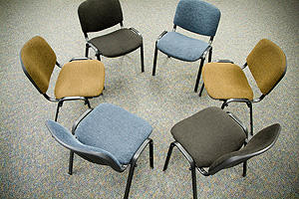
Visual Cues
Poster Boards
Tasking Boards
Hand Gestures
Visual Load the 12 Steps- with signs and symbols meaningful to the client

Slide 21
What is Mindfulness?
To practice mindfulness means to:
Adopt a nonjudgmental stance to our experience
Practice patience
Loosen our grip on what we “know” about our experience
Trust our thoughts feelings and experience
Recognize the urge to get and hold pleasant experience and push away unpleasant experience
Experience the qualities of acceptance
Let go

Slide 22
Rationale for Mindfulness Group
Reinforces Experiential Learning
Client’s with Brain Injuries often cannot remember specific details of a session but can remember how they felt about it.
Group fits in well with other services including, exercise program, recreational therapy outings, outdoors activities, art projects and music therapy
Offers concrete intervention to minimize impact of mental health symptoms including, low frustration tolerance, anxiety, depression and impulsivity.
Consistent with Vinland Center’s goal of treating mind body and spirit

Slide 23
How is it Helpful?
Increased activation of areas of the brain associated with
  Executive Decision-Making
  Self directed Attention
  Emotional processing and regulation
Higher rates of self efficacy
Higher rates of perceived quality of life
Greater recognition of positive experiences
Reduced reactivity
Source: JFK Johnson Rehabilitation Institute

Slide 24
Creating Cultures of
Trauma-Informed Care
Core Principles of a Trauma-Informed System of Care
Safety: Ensuring physical and emotional safety
Trustworthiness: Maximizing trustworthiness, making tasks clear, and maintaining appropriate boundaries
Choice: Prioritizing consumer choice and control
Collaboration: Maximizing collaboration and sharing of power with consumers
Empowerment: Prioritizing consumer empowerment and skill-building
Source: Roger Fallot, PhD, Community Connections

Slide 25
Definition of Trauma
The person’s response to the event must involve intense fear, helplessness, or horror (or in children, the response must involve disorganized or agitated behavior).” (American Psychiatric Assoc. [APA] 2000, pg. 463)
Trauma occurs when an external threat overwhelms a person’s internal and external positive coping resources. (Bloom and Fallot, 2009)

Slide 26
Effects of Trauma
Estrangement; a sense of isolation or disconnection from others or the environment
Feelings of powerlessness or helplessness
Changes in one’s understanding or view of oneself or of the self in relation to others; a change in world view
Devastating fear; loss of safety or trust that may relate to interpersonal interactions, treatment practices or specific environments
Feelings of shame, blame, guilt & stigma
Source: Adapted from Blake, M. (2010).6

Slide 27

Resiliency
The study of why things go right, even though the odds say they should have gone wrong
Initial studies were of individual resiliency
More recently research has also focused on family and community resiliency

Slide 28

Resiliency
Is the ability to not only survive, but thrive!
In order to remain strong, we must stretch ourselves and spring forward!

Slide 29
What Is Illness Management and Recovery (IMR)?
IMR includes education about mental illness but emphasizes putting information into action through the development of personal goals. IMR strongly emphasizes helping people set and pursue personal goals and helping them put strategies into action in their everyday lives.

Slide 30
IMR Practice Principles
Consumers define recovery.
Education about mental illnesses , chemical dependency and Brain injury is the foundation of informed decision-making.
The Stress-Vulnerability Model provides a blueprint for illness management.

Slide 31
IMR Practice Principles
Collaborating with professionals and significant others helps consumers achieve their recovery goals.
Relapse prevention planning reduces relapses and re-hospitalizations.
Consumers can learn new strategies for managing their symptoms, coping with stress, and improving their quality of life.

Slide 32
Topics about 8 Parameters of Health
Strength
Flexibility
Endurance
Balance
Coordination
Posture
Nutrition
Body Mechanics

Slide 33
Strength
3 times each week with a rest day between sessions is recommended
Health clubs vs. home programs:
Health clubs:
Pros: Newest, highest quality equipment,
latest trends and classes
Cons: Expensive, waiting for equipment, not convenient
Home programs:
Pros: Inexpensive usually, very effective if initial
consult is guided and structured
Cons: Home distractions

Slide 34
Flexibility
Benefits:
Decrease chance of injury/re-injury
Improve joint function
Decrease neck and back pain
Reduced muscle tension
Improved circulation and overall energy

Slide 35
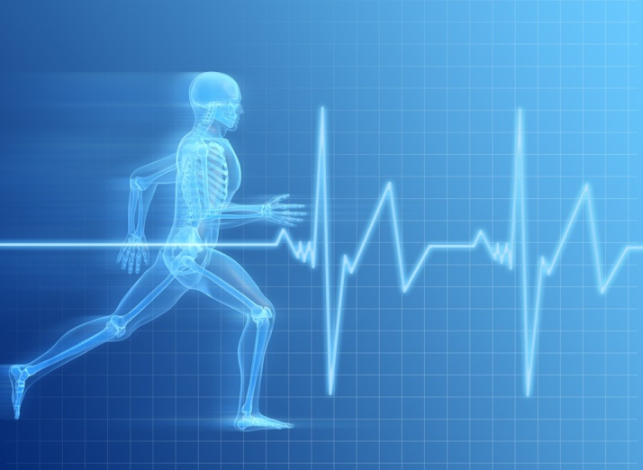
Endurance/Aerobic
Benefits:
Increases the overall strength of your heart and lungs making them more efficient
Increase metabolic rate
Reduce risk of obesity, heart disease, hypertension, type II diabetes, strokes and some cancer
Increase HDL (Good Cholesterol) and reduce LDL (Bad Cholesterol)
Start out at a slow pace then gradually build up over time, remember the talk test.
Plan a time of day that works best in your schedule
Frequency: A minimum of 3 times each week to daily.
Intensity: 65-85 percent of your max heart rate which is 220-age.
Duration: 20 minutes minimum building up to 40 minutes or longer.
Remember, cardiovascular exercise should be fun not exhausting.

Slide 36
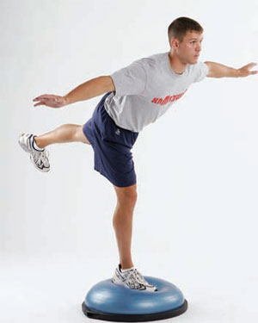
Balance and Coordination
Balance and coordination exercises are a big part of any fitness and wellness program
Activities include using wobble boards, bosu® trainers, balance beams and physioballs
Exercises can be performed most days of the week
Benefits:
Increased safety when performing ADL
Prevent injury from falls
Improved athletic ability
Improved core strength which improves posture
Improved joint stability
Stimulates brain activity

Slide 37
Posture
Posture helps determine the amount and distribution of stress we place on bones, muscles, tendons, ligaments and discs
Core strength is important along with middle back and posterior shoulder exercises
Pay attention to sit, stand, lift, carry, twist, turn and bend
Research shows that people who exercise regularly are less likely to suffer from back injuries and pain
The three key components are strengthening, stretching and cardiovascular activities
Postural mistakes include:
1. Slouching
2. Rounding the shoulders
3. Hiking the shoulders
4. Forward head position
5. Chin tilted upward
6. Forward trunk lean
7. Locking the knee
Benefits:
Improved appearance
Decreases chance of osteoporosis
Decreases risk of arthritis
Decreases risk of cervical and lumbar pain

Slide 38
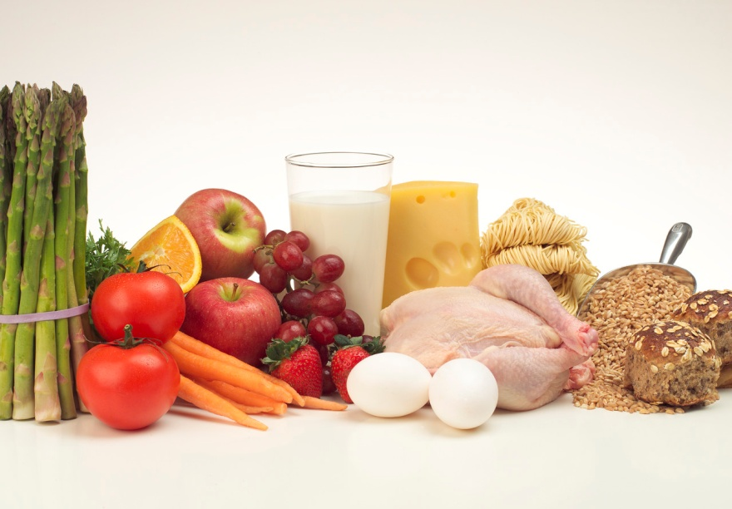
Nutrition
The key is to eat healthy most days of the week, eating from all the food groups.
Try to eat smaller portions several times each day vs. few large meals.
If you crave a sweet, have one, but make it a small one.
Try to include several sources of anti oxidants daily.
Healthy eating consists of:
Complex carbohydrates
Lean sources of protein
Monounsaturated or polyunsaturated fats
Recommended Daily Amounts:
50-60% of caloric intake comes from carbohydrates
20-30% from protein
20-30% from fat
Carbohydrates: 4 calories per gram
Protein: 4 calories per gram
Fat: 9 calories per gram

Slide 39
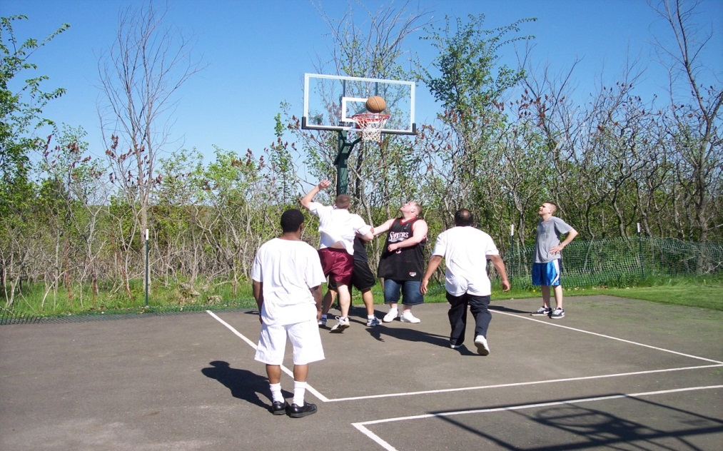
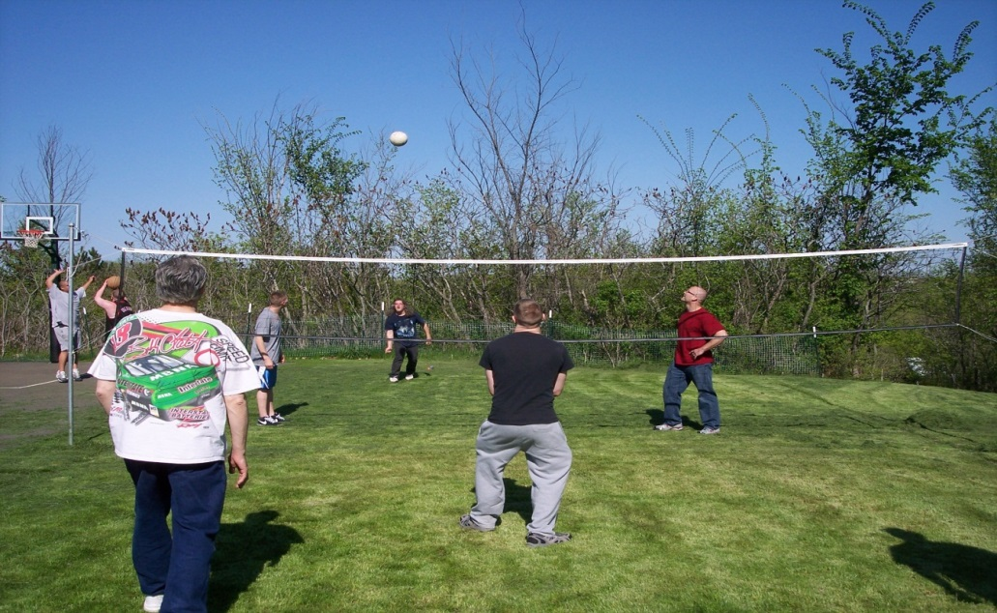




Therapeutic Recreation

Slide 40

Vinland National Center
Rick Krueger, Clinical Services Manager
rkrueger@vinlandcenter.org

