Slide 1
Substance Use Disorders
Carmen Finn MA, LADC, ADC-MN
Clinical Director
Recovering Hope Treatment Center

Slide 2
Objectives
Overview of substance abuse as
a brain disease
Impact of chemical dependency on a parent’s ability to safely parent their child
Treatment options
Short- and long-term outcomes and recovery prognosis
Impact of recovery prognosis on child protection permanency timeline
Understanding how attorneys can best represent parents who have substance abuse disorders

Slide 3
What is Addiction
“Addiction is a primary, chronic disease of brain reward, motivation, memory and related circuitry. Dysfunction in these circuits leads to characteristic biological, psychological, social and spiritual manifestations. This is reflected in an individual pathologically pursuing reward and/or relief by substance use and other behaviors.”
(American Society of Addiction Medicine)

Slide 4
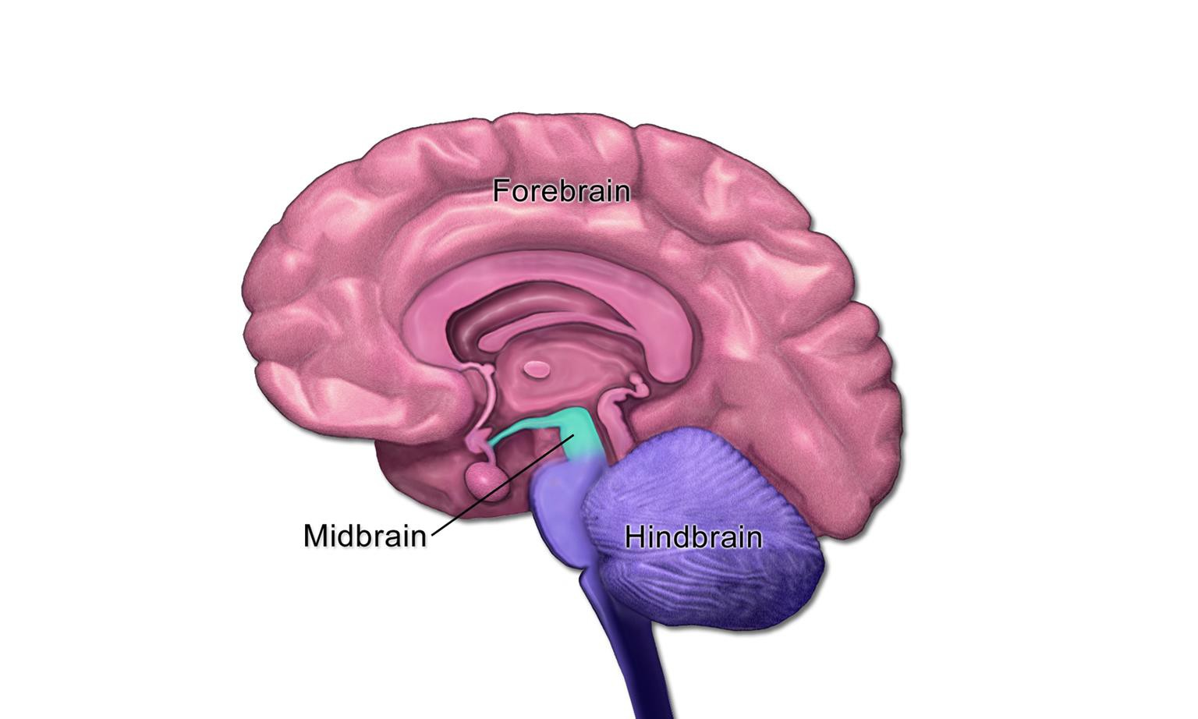

Slide 5
Brain Disease
We all have a mechanism in our brains (Midbrain) that helps us remember when we are engaging in activities that help us survive. Eat, sleep, stay/run away, etc. When this reward circuit becomes active through engaging in one of these activities, our brain notes that event and helps us to remember to do it again and again without thinking about it.
Unfortunately, drugs stimulate this same circuit of survival and reward.

Slide 6
drugabuse.gov

Slide 7
How it develops
Drugs produce more dopamine (2 to 10 times the amount) when taken than natural rewards (eating, sleeping) and therefore, after awhile, your brain prefers drugs to all other sources of reward.
Drugs become more important than eating, sleeping, friends, family, happiness. Externally, providers and others begin to see behaviors from the individual that are actually symptoms of the disease.

Slide 8
Symptoms
Preoccupation
Dependence and Withdrawal
Unsuccessful attempts to stop or reduce use/drinking
Engaging in more and more time spent trying to obtain or use the drug/drink.
Important other aspects of the individual life are given
up, become less, or are not pursued.
Continued use despite the risks or continued
consequences. (legal, CPS, employment)

Slide 9
Impact regarding ability to parent
Children are three times more likely to be abused and four times more likely to be neglected if their parents abuse substances.
Children have an increased risk of developing substance use disorder if their parents were substance abusing, which highlights the importance of working on disrupting the cycle of intergenerational substance use.
An effective intervention is necessary to break the cycle.
(SAMHSA 2000)

Slide 10
Treatment Options
Outpatient or Intensive Outpatient
Inpatient/Residential
High, Medium and Low Intensity
MI/CD - Addressing both mental and chemical health
Family or Individual
Culturally specific, or special populations

Slide 11
More Treatment Options
Medication-Assisted Therapy
Suboxone, Methadone
Partial and full Hospitalization Detoxification
There are many options out there - a full and thorough a assessment can assist client and referent in determining the right course and combination.

Slide 12
Recovering Hope Treatment Center
A snapshot of a treatment option:
Family Treatment - parent and child may live together throughout the treatment process, or parent can reunify while in treatment.
Co-occurring - Provides services addressing both mental health and substance use disorders.
Trauma-Informed - Addresses past trauma of both mother and child
while creating a safe environment to heal.
Parenting and Family Services - each client receives weekly parenting education.
Coordination of child visits, collateral meetings with CPS.

Slide 13
Recovery and Prognosis
Addiction can be managed like other diseases - treatment, monitoring, intervention, a continuum of care.
Decrease number of relapses, frequency and intensity. Increase periods of abstinence and remission.
Improve quality of life.

Slide 14
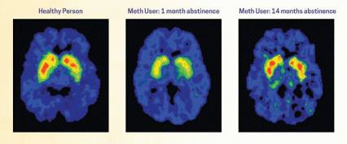
Recovery
“These images showing the density of dopamine transporters in the brain illustrate the brain's remarkable ability to recover, at least in part, after a long abstinence from drugs—in this case, methamphetamine.” (NIDA)
Source: The Journal of Neuroscience, 21(23):9414-9418. 2001

Slide 15
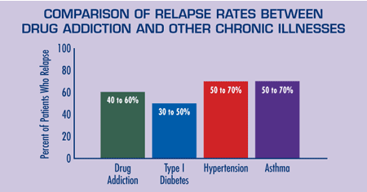
Recovery and Prognosis
drugabuse.gov

Slide 16
Recovery
A report from NIDA indicated that clients who had
improved after one year, continued to improve after 5.
“Research shows that combining treatment medications (where available) with behavioral therapy is the best way to ensure success for most patients.” (NIDA 2016)

Slide 17
Understanding How Attorneys Can Best
Represent Parents Who Have A SUD
Ask for and request Substance Use Assessments early to screen for substance use disorders within the family.
Be aware of resources, such as family treatment options, that provide a residential
setting for parents to live with their children while receiving treatment services.
Request frequent and ongoing collaboration between parent, substance abuse treatment providers, and CPS.
Request clear, attainable goals in a case plan to assist both parent and providers in understanding what the court and legal team expect.
Seek additional trainings, or contact knowledgeable persons in the field to ask questions or learn more about changes in the field, best practices, and current research.
Recognize and understand addiction as a disease and recovery is possible.

Slide 18
References and Resources
www.asam.org
www.drugabuse.gov
Center for Substance Abuse Treatment. Substance Abuse Treatment for Persons With Child Abuse and Neglect Issues. Treatment Improvement Protocol (TIP) Series Number 36. DHHS Publication No. (SMA) 08-3923. Rockville, MD: Substance Abuse and Mental Health Services Administration, 2000.
www.dhs.state.mn.us/healthcare/studies
https://www.drugabuse.gov/publications/research-reports/therapeutic-communities/are-therapeutic-communities- effective
https://www.samhsa.gov/sites/default/files/partnersforrecovery/docs/Briefing_Substance_Use_Treatment.pdf

